Slide 1
PRIMs tutorial Unit 1 (second lecture)
Niels Taatgen

Slide 2

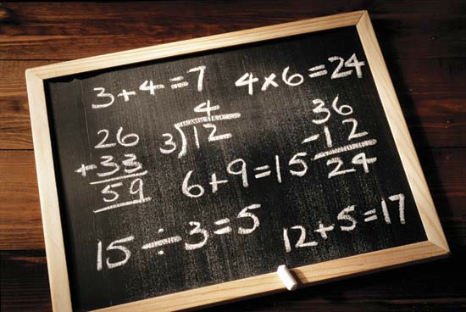
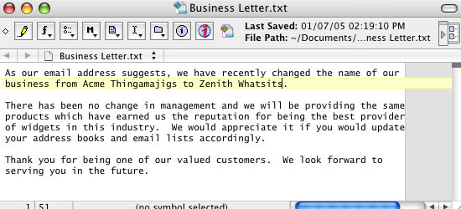
Cognitive skills

Slide 3
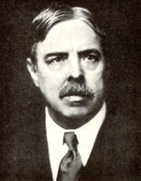
Cognitive modeling/science/psychology view
Each task on its own, little transfer
Identical elements (Thorndike, 1904)

Slide 4

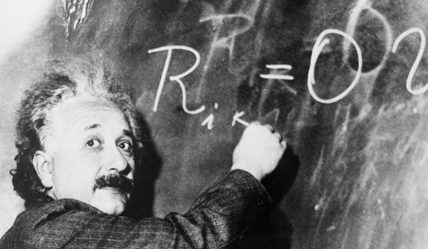


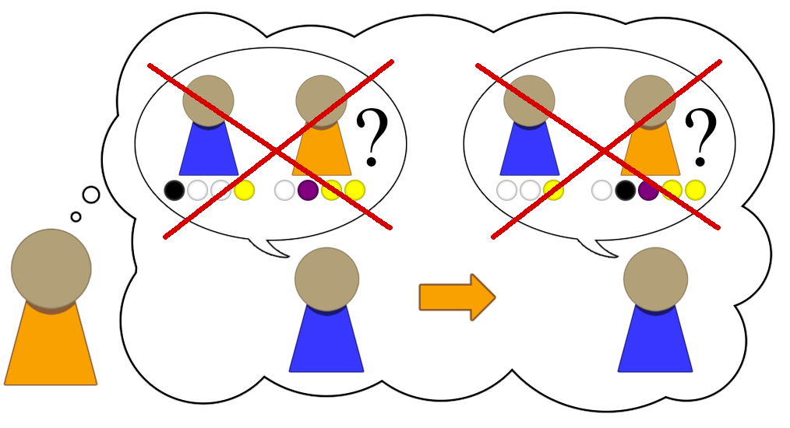





32
19
+ --
51
3 + 2 = 5
A B C ...
Notes:
If we want computers to be intelligent, they will have to start learning like humans. They should start with very simple thinking skills, and build upon these towards increasing complexity. Only then can computers achieve the same incredible mental flexibility that humans have.

Slide 5
Key idea in PRIMs
General Strategies are a byproduct of learning specific skills

Slide 6
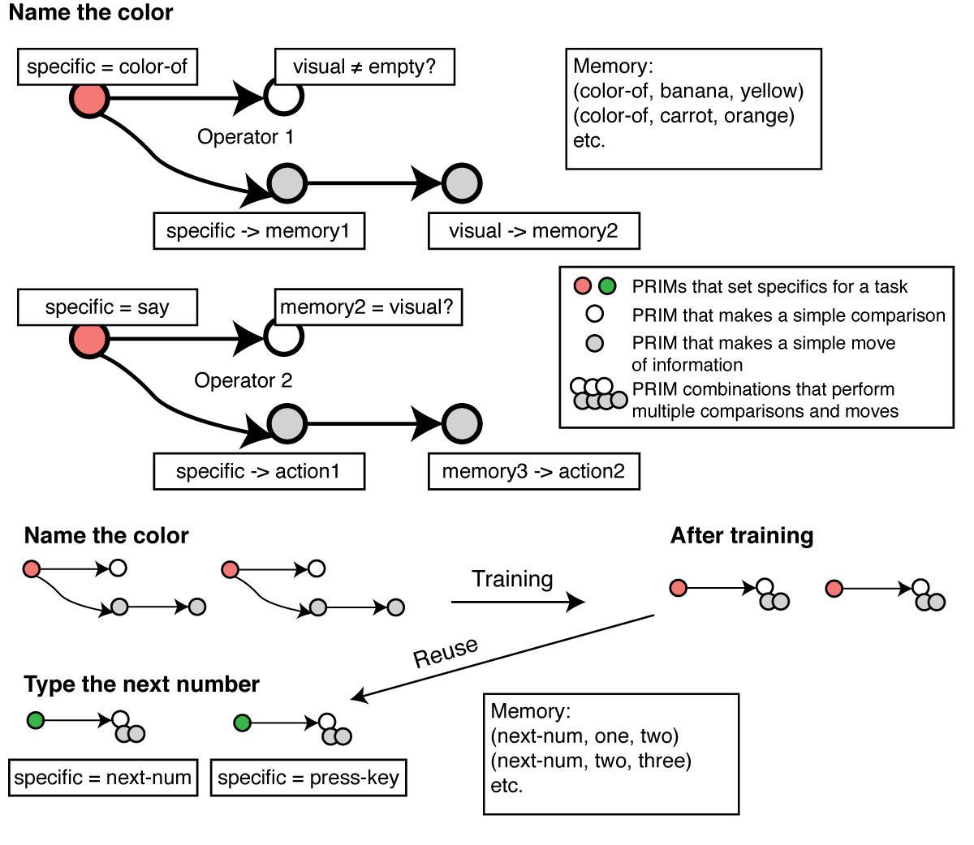

Slide 10
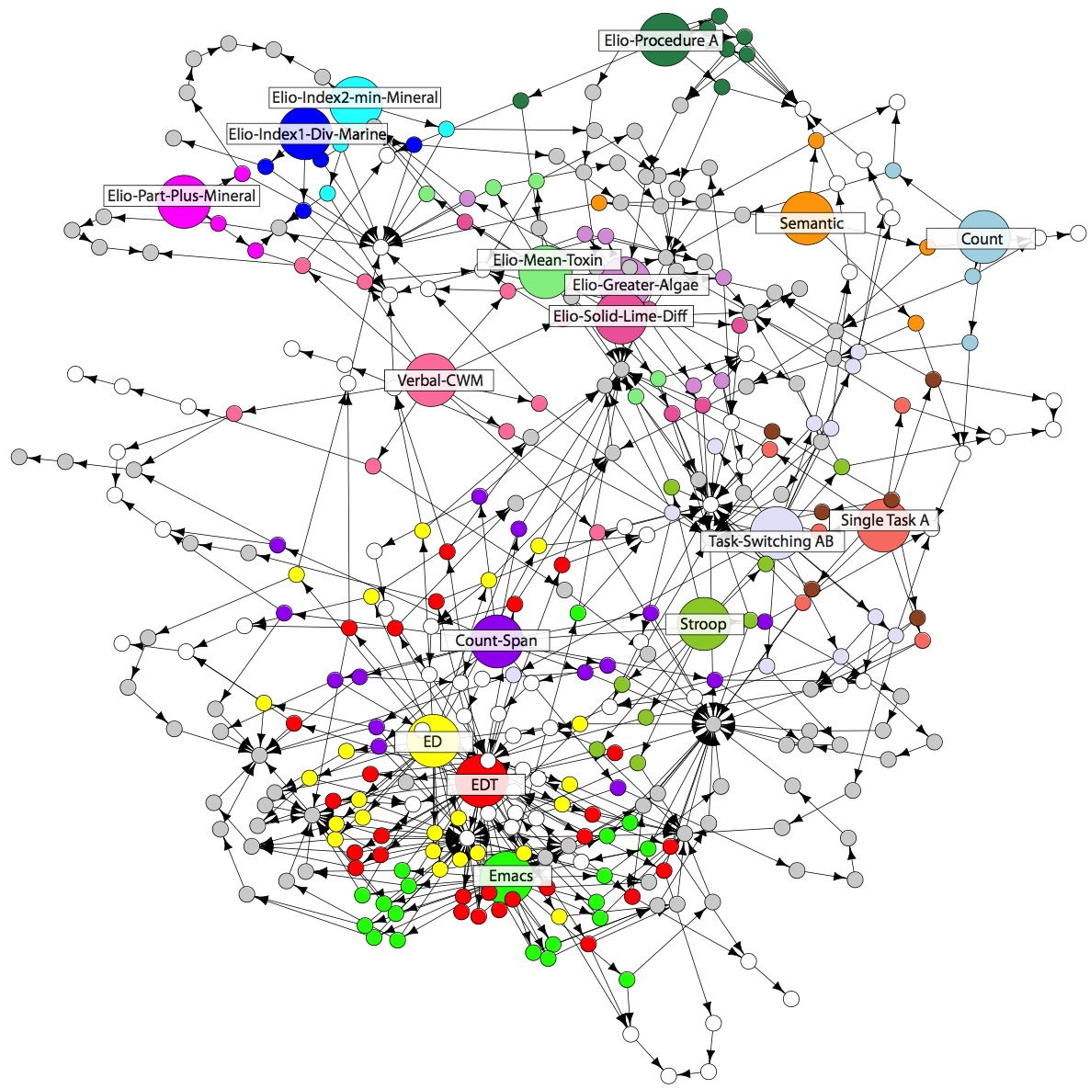
Long term goal: Expand PRIMs into a theory of life-long learning

Slide 11
Possible strategies that can be trained
How to handle task hierarchies and multitasking?
How to control working memory
Rehearsal is a learned strategy, not a brain mechanism
Make decisions while anticipating future consequences of that decision

Slide 12
Accomplishments of PRIMs
Transfer between text editors
Explanation for several brain training experiments (proactive control)
Explanation of why the attentional blink can be trained away
Models of distraction
Models of cognitive development

Slide 13
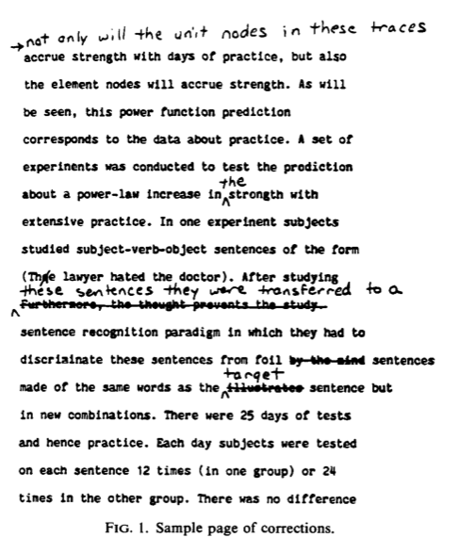
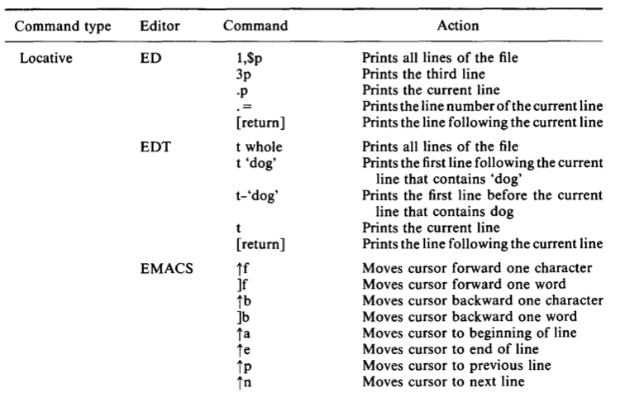
A real example: editors Singley & Anderson 1985

Slide 14
Their findings
Huge transfer between two line editors (ED and EDT)
Smaller, but still decent transfer from line editors to Emacs
Their model: identical productions

Slide 15
Experimental design
6 day experiment
5 conditions, which differed with respect to the editors used
ED – ED – EMACS
EDT – EDT – EMACS
ED – EDT – EMACS
EDT – ED – EMACS
EMACS – EMACS - EMACS

Slide 16
Data from that experiment

Slide 17
Model of this task
Borrows from Singley & Anderson 1985, who borrowed from Card, Moran & Newell 1983
Basic structure
Go to the relevant line for the next edit
Do the edit in that line

Slide 18
The model
Each editor has its own operators in declarative memory
However, there is overlap in the task-general (“gray”) chunks

Slide 19
Overlap between the three models
Ed and Edt are very similar, except for the strategy to move multiple lines and the particular keys that are used
Emacs has the same global strategy, but differs in the details
This is reflected in the model in that Ed and Edt share more of the specific condition and action chunks.

Slide 20
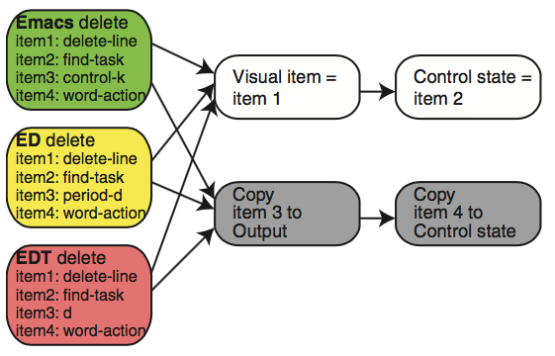
Identical: delete a line

Slide 21
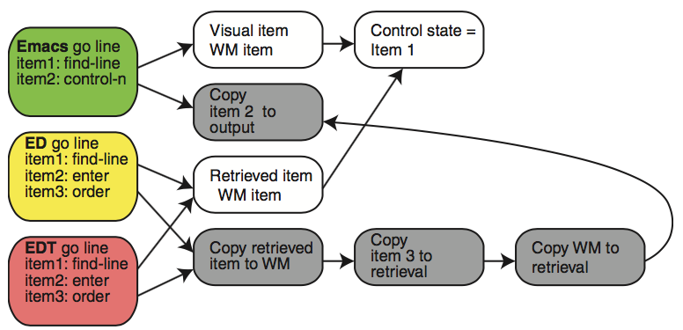
Somewhat different: Move to the right line

Slide 22
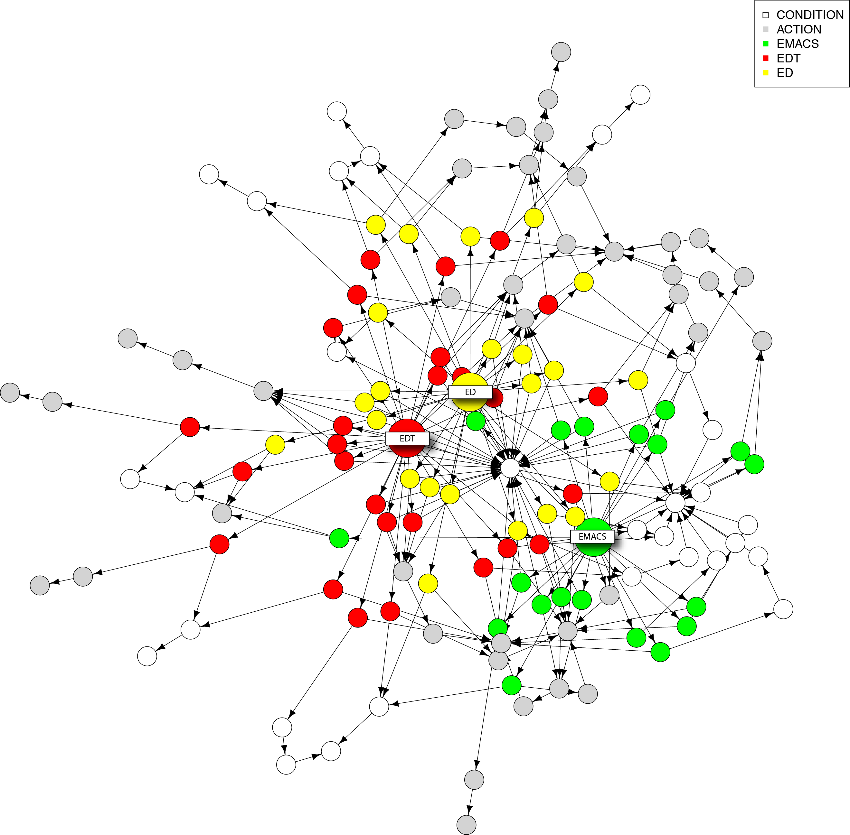

Slide 23
Transfer data/model comparison
Training condition | Human data | Identical productions | PRIM model
Line editor to other Line editor | 95% | 79% | 88%
Line editor to Emacs | 61% | 33% | 61%

Slide 24
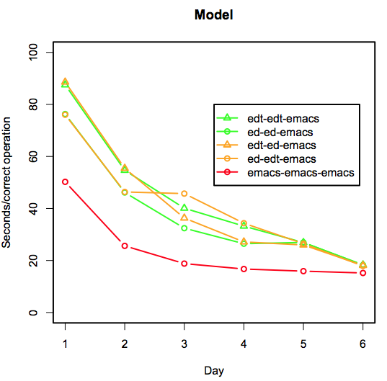
Model results

Slide 25
Difference between PRIMs and identical productions
PRIMs is consistent with the idea of identical elements
But the elements are smaller
Identical productions was not a real processing model

